Slide 1

ME 224 Course Project
Gearless Power Transmission
02/05/2024
by
Amit
220103010
Department of Mechanical Engineering
Indian Institute of Technology Guwahati

Slide 2

Motivation and Application
For transmitting motion, gears are one of the most used mechanical parts. However, they are subjected to wear and tear and require high accuracy to be designed. Also, gears are expensive.
We have thought of replacing the gears with a simple mechanism which is simple to manufacture and is cost efficient as well. We can use this design in areas where there is not high impact force acting on the machine parts.
We have designed this mechanism for use in a paddle boat.
We cannot use directly the motion of peddles to rotate the propeller as it will cause the person to be sitting facing the sides and not facing the front of the boat.
(Continued on next slide)

Slide 3
Motivation and Application
.
The peddling and thus rotation of a shaft by a person would be turned by 90 degrees in another shaft which will finally lead to the rotation of the propeller. The rotation of the propeller will lead to the movement of the boat.
Details about the transmission of motion and movement of the boat are provided in the upcoming slides.

Slide 4
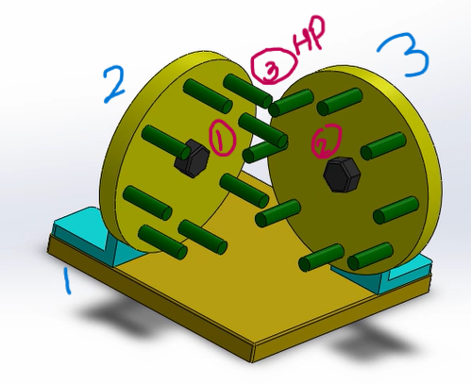
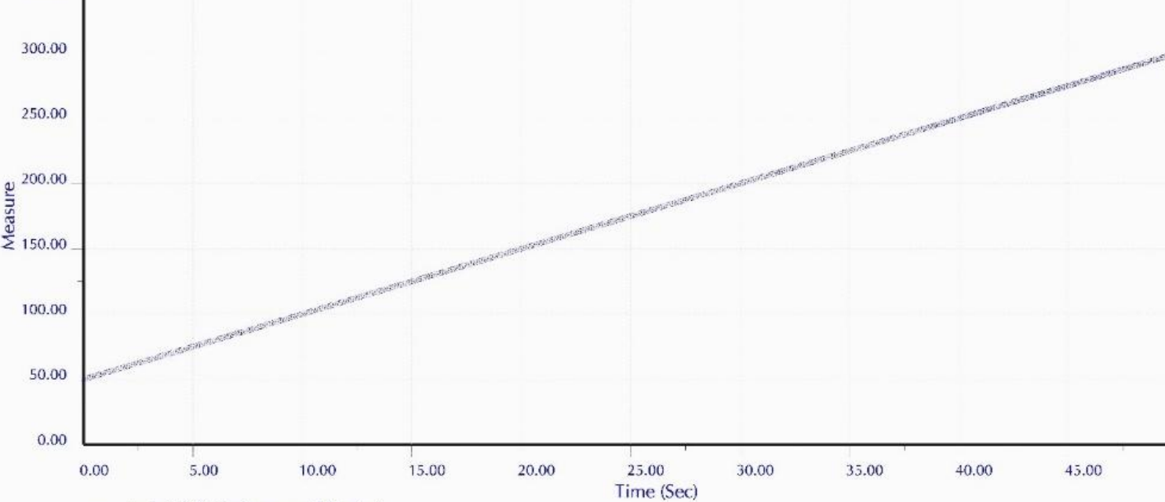
Kinematic Analysis
Number of links = 3 ( the two discs and the ground)
Number of lower pair joints (P1) = 2 ( the two joints on the discs)
Number of higher pair joints (P2) = 1 (the point of contact of the cylinders
Degree of freedom of the mechanism = 3(n-1)-2P1-P2
= 3(3-1)-2*2-1 =3*2-4-1 =1
Velocity profile: at output and input disk are similar.

Slide 5
Kinematic Synthesis
The mechanism consists of two discs with equal radii.
On both discs, an equal number of cylindrical rods are mounted.
The rods are equally placed near and along the periphery of the discs.
The axis of rotation of the discs are at 90 degrees to each other and the shafts are intersecting.

Slide 6
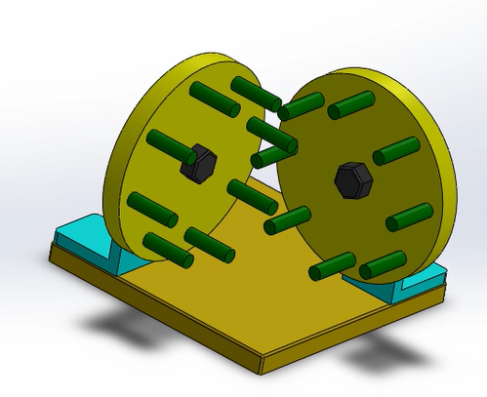
Computer Aided Design
CAD with video/ motion analysis is on the 8th slide

Slide 7
Motion Analysis / Study
When a person peddles the peddles, the input shaft will be rotated which will lead to rotation of our input disc.
The rods of the input disc would come in contact with the output disc which will lead to movement of the output shaft. The rotation of the output shaft varies from that of the input shaft by 90 degrees.
The output shaft will rotate the propeller which by the help of thrust force helps in the movement of the boat.
This helps the person face front while peddling the boat, otherwise, to transmit motion without any intermediate mechanism to the propeller which is located at the back side of the boat, the person has to sit facing sideways.

Slide 8
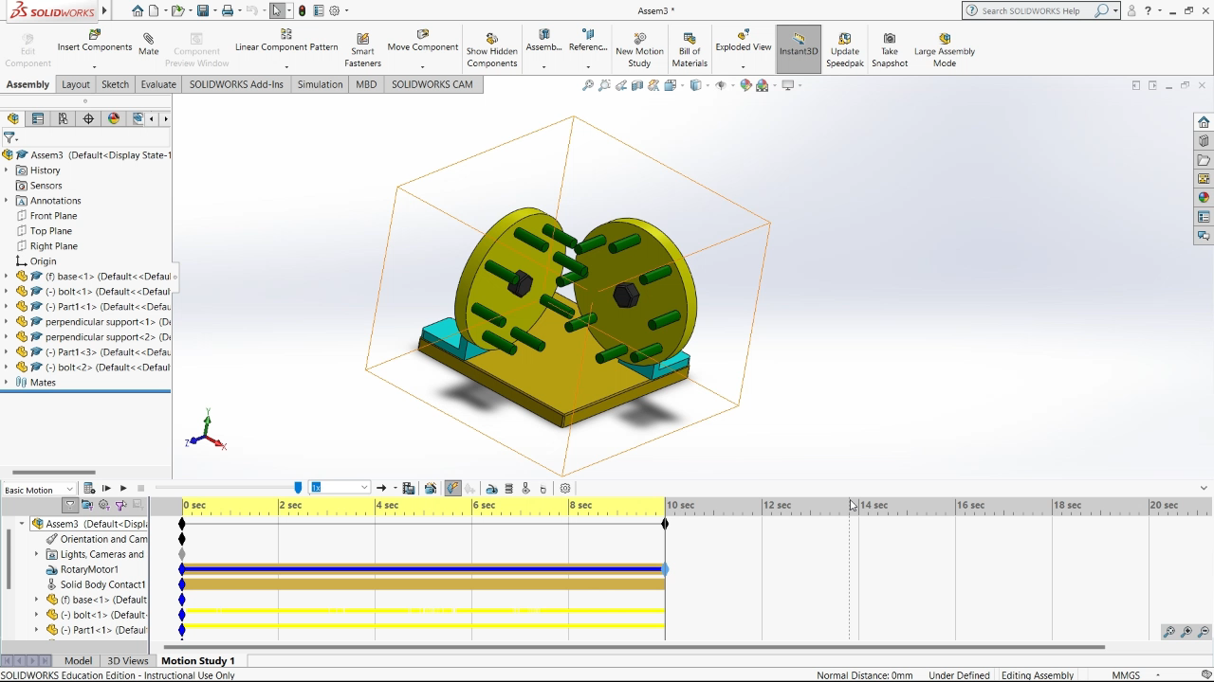
Motion Analysis / Study

Slide 9
Conclusions
Thank you Sir, for giving us an opportunity to explore some topics and do some research on “Kinematics of Machinery”.
We really enjoyed the project and the process of arriving to design this mechanism and finally accomplishing it.
This project has intrigued us to know more and explore more about this subject. Thank You.

